Slide 1

The Process of a Ballot
Coos County
Julie A. Brecke, Coos County Clerk
https://co.coos.or.us/elections

Slide 2
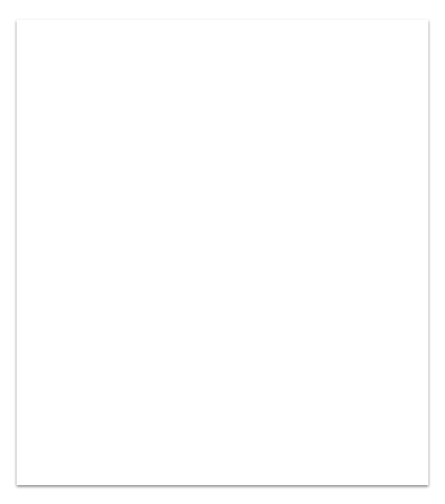
If you have been to the DMV recently, please keep an eye out for election mail and be sure to respond, as Oregon Motor Voter works in partnership with the Oregon Secretary of State (SOS).
Even 16 year olds will be registered to vote when obtaining their driver’s license, but aren’t eligible to vote until 18 years old. So look out for a letter from the SOS after going to the DMV.
Oregon is a Vote by Mail State
To check your registration status, go online to:
www.oregonvotes.gov/myvote
October 13, 2026 is the last day to register for the November 2026 Midterm Election
www.oregonvotes.gov/register

Slide 3
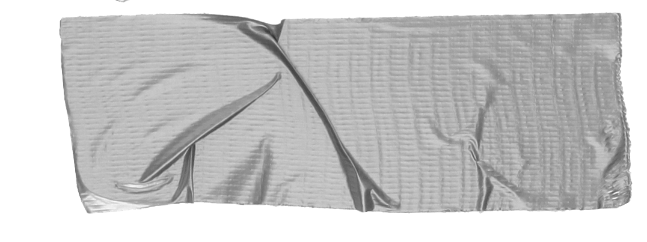
Important Election Dates for November 2026 Midterm
October 13, 2026
Last day to register to vote. Registration cards postmarked by this date or submitted online no later than 11:59 pm are valid.
October 14, 2026
First day ballots are mailed to voters.
November 3, 2026 Election Day
County Clerk's office open 7 am - 8 pm. Last day for voter to return ballot. Ballots that are mailed must be postmarked by election day. Ballots deposited in an official drop box must be received by 8 pm on election day.
December 10, 2026
Final election results certified.
Did you know?
Coos County does not produce a voter pamphlet, however during state and federal elections the state does.
Candidates must submit their own statement to the voter pamphlet and sometimes they choose not to.
There is no voter pamphlet for Special District elections, but candidate filings may be viewed on our website.
Tip
Only one voter pamphlet is mailed to each house. You may also pick one up at the library or the courthouse or view it online at the Secretary of State’s page.

Slide 4
Ballot Design
If you update your voter registration, make a change at the DMV or move in the two months before an election you may receive multiple ballots. This is because the original ballot is included in the general mailing proof that is made 50 days before the election. A reissued ballot is created when you made the change. Be sure to read the note included and reach out to our office with questions.
Your ballot begins. . .
Your ballot is prepared in our office about 50 days before the election by full-time election staff and a proof is sent to the printing and mailing company. This allows time for absentee mailing and general mailing. General mailing is 20 days before the election, as required by Oregon statute.

Slide 5
Ballots are Mailed to Voters
Approx. 2 weeks before an election ballots are mailed.
If you do not receive your ballot after one full week, call our office at 541-396-7610 and we can help.
If you receive someone’s ballot whom no longer lives at your address or you know has died, “write does
not live here” or “deceased” and place
it back in the mail and it will come back
to our office so we can remove them.
*It is against the law to hold onto someone else’s mail.
Tip
If you need an absentee ballot check out this link:
https://co.coos.or.us/files/c5fb3da4d/SEL111.pdf

Slide 6

Voting
Making Selections
  Fill in the oval by your choice with a black or blue ink pen
  Voting all contests is not required
Optional Write-in
  To add a candidate, fill in the oval and print the name clearly
  For a write-in to count, it must be a name
Check for Errors
  If you make an error, draw a line through the entire choice you do not want, and fill in the oval next to the choice you do want
  If you vote for more options than are allowed, your vote will not count for that candidate or measure
If you still have questions, feel free to contact us
  Email: elections@co.coos.or.us
  Phone: (541) 396-7610
  In Person: 250 N Baxter St, Coquille, OR 97423
TIP:
Sign your ballot however you typically sign. If you are not sure, check your driver’s license to see how you signed at the DMV.

Slide 7
Returning Your Ballot
After voting your ballot and placing it back in it’s envelope, MAKE SURE THAT YOU SIGNED IT!
Return Options
Ballot Box: Coquille-Courthouse, Bandon-Library, Myrtle Point-City Hall, Lakeside-City Hall, Powers-Library, Coos Bay-City Hall, North Bend-Library
https://co.coos.or.us/drop-site-locations During Primary, General and Special District elections, teams of two election couriers of different political parties collect from ballot boxes.
Mail: It is recommended that you mail your ballot at least one
week before the election date. If the election is less than a week away,
we recommend using a ballot box. If you choose to use USPS, have
the postal worker date stamp your envelope.
You may also return your ballot to:
Coos County Election Office-Coos County Courthouse
Tip
Vote Early and if you are going to wait until election day, drop it in a ballot box before 8pm to ensure your ballot is received in time

Slide 8
Ballot Arrival in Election Office
Ballots are placed in blue trays that are labeled with the date and location of where they were received from (i.e. specific ballot box location, mail, counter).
Each ballot envelope has a barcode that is scanned into the Oregon Centralized Voter Registration (OCVR) and moved to a yellow tray.
At this time, voters may see that their ballot has been received by checking the Oregon Secretary of States’ My Vote portal:
www.oregonVOTES.gov/MyVote
Observers will see colored trays designating which stage of the process ballots are in:
▪ Blue trays contain voted ballots that have not been scanned into
OCVR
▪ Yellow trays contain voted ballots that have been scanned into OCVR, but have not undergone signature verification
▪ Red trays contain voted ballots that have been scanned into OCVR and contain a matching signature

Slide 9

Voted ballots that contain matching signatures are not moved onto the next stage in the process until full-time staff have balanced against reports from OCVR. This is another step in our checks and balance system.
www.oregonvotes.gov/myvote
After balancing, red bins are moved to the tabulation room and envelopes are opened using an automatic envelope opener.

Slide 10
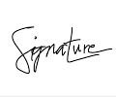
Signature Verification
Each signature on a return identification envelope is compared against the signature in the voter registration record by trained staff. Once verified the envelopes are moved to a red bin.
If there are any problems, such as the signature on the envelope not matching the voters’ record, or the signature is missing from the return envelope, the voted ballot is stored separately and notices are sent to the voter.
These voters have up to 21 days after election day to resolve the issue, so that their vote can still be counted
Name Change:
If you have had a name change, your election office needs you to update.
Updating your signature: If your signature has changed overtime, complete a new registration card with your updated signature.

Slide 11
OPENING BOARDS
o Each opening board is made up of two individuals of different political parties, with a full-time staff member present.
o The job of the opening board is to prepare the ballots for tabulation.
o One person will remove the voted ballot from the return identification envelope.
o The other person will unfold and flatten the ballot.
o If a ballot is in such a state that it is impossible to feed through a scanner for tabulation, the ballot is duplicated by two board workers under the supervision of full-time staff
You May Sign Up to Observe
Observers will see the return identification envelopes are kept face down so
that the name of the voter cannot be seen.
Observers will see the first person holding up the return identification envelopes in order to look through the hole in the center of the envelope.
This is done to verify all voted ballots have been removed from the
envelopes.
Observers will see both individuals creating stacks of envelopes and ballots.
This is done to aid in balancing the number of voted ballots before
they are moved onto the next stage of the process.
Observers will see ballots for tabulation go into white boxes with a designated number.
Observers will see the empty return identification envelopes go into a black
tray with an identical designated number and placed on the shelf.

Slide 12
Tabulation
Full-time staff process one batch of voted ballots at a time, scanning them to be tabulated by Clear Ballot.
Once all ballots are scanned, the number of ballots scanned is balanced against the number provided by the opening boards.
Observers will see colored tags on each white box containing voted ballots.
▪ Blue tags indicate ballots ready for tabulation.
▪ Green tags indicate ballots that have already been tabulated.
MYTH: Tabulation machines are connected to the internet.
FACT: Clear Ballot systems are NEVER connected to the internet and there is an air gapped system for transferring results.

Slide 13
Adjudication
After ballots have been tabulated, two full-time staff members, of different political parties, review electronic images of ballots to ensure that votes were tallied correctly. If you have ever marked the wrong choice, crossed it out and marked a new option, then this is the process that ensured your vote was counted the way you intended.
Adjudication is carried out by direction from the Oregon Secretary of State in the form of the Vote by Mail Manual.
This process is completed before the election is certified, no later than 27 days after the election.
Observers will see full-time staff reviewing each contest and candidate methodically while logging their progress. Go to the election website if you would like to sign up to observe.
https://co.coos.or.us/observation

Slide 14
HAND COUNT
Your ballot may be Hand Counted. . .
After statewide and federal elections, counties perform post-election reviews. The Secretary of State issues a directive to all Oregon counties ordering a hand count audit of specific contests and batches or precincts. In Coos County, a selection of ballots are hand counted by teams of employees, of different political parties, with results compared against tabulator results.
Observers will see each batch is split between the two teams of a board.
Observers will see, once both teams have finished counting, they log their findings and switch ballots with the other team to repeat the process.
This process ensures each batch is counted twice.
Observers will see a seal is broken upon the beginning of and placed upon the completion of each batch.

Slide 15
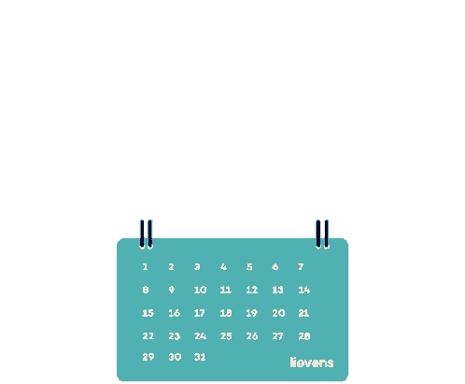
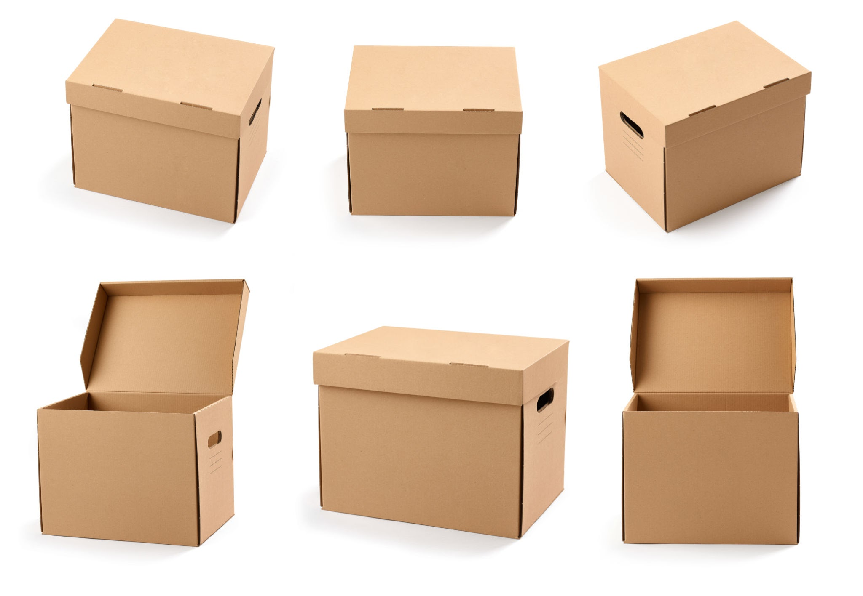
Your ballot is stored. . .
All retained materials are labeled and dated for destruction. When that day arrives, a shredder company does this in-house and documentation is done.
After certification and hand counts, ballots and return identification envelopes are moved to a larger secure storage area for retention. Federal law requires voted ballots to be held for approximately two years after a federal election.

Slide 16
Public Record Questions
Can someone find out how I've voted?
No. The ballot counting process ensures the privacy of each vote. If you are interested in learning more about the process, please consider observing an election
Can someone find out that I didn't vote in an election?
Yes. Whether or not someone cast a ballot during an election is public record.
Can someone find out that I signed a petition?
Yes. The list of people who signed a completed petition is public record.
For more FAQs check out: Frequently Asked Questions (FAQs) - Coos County

Slide 17
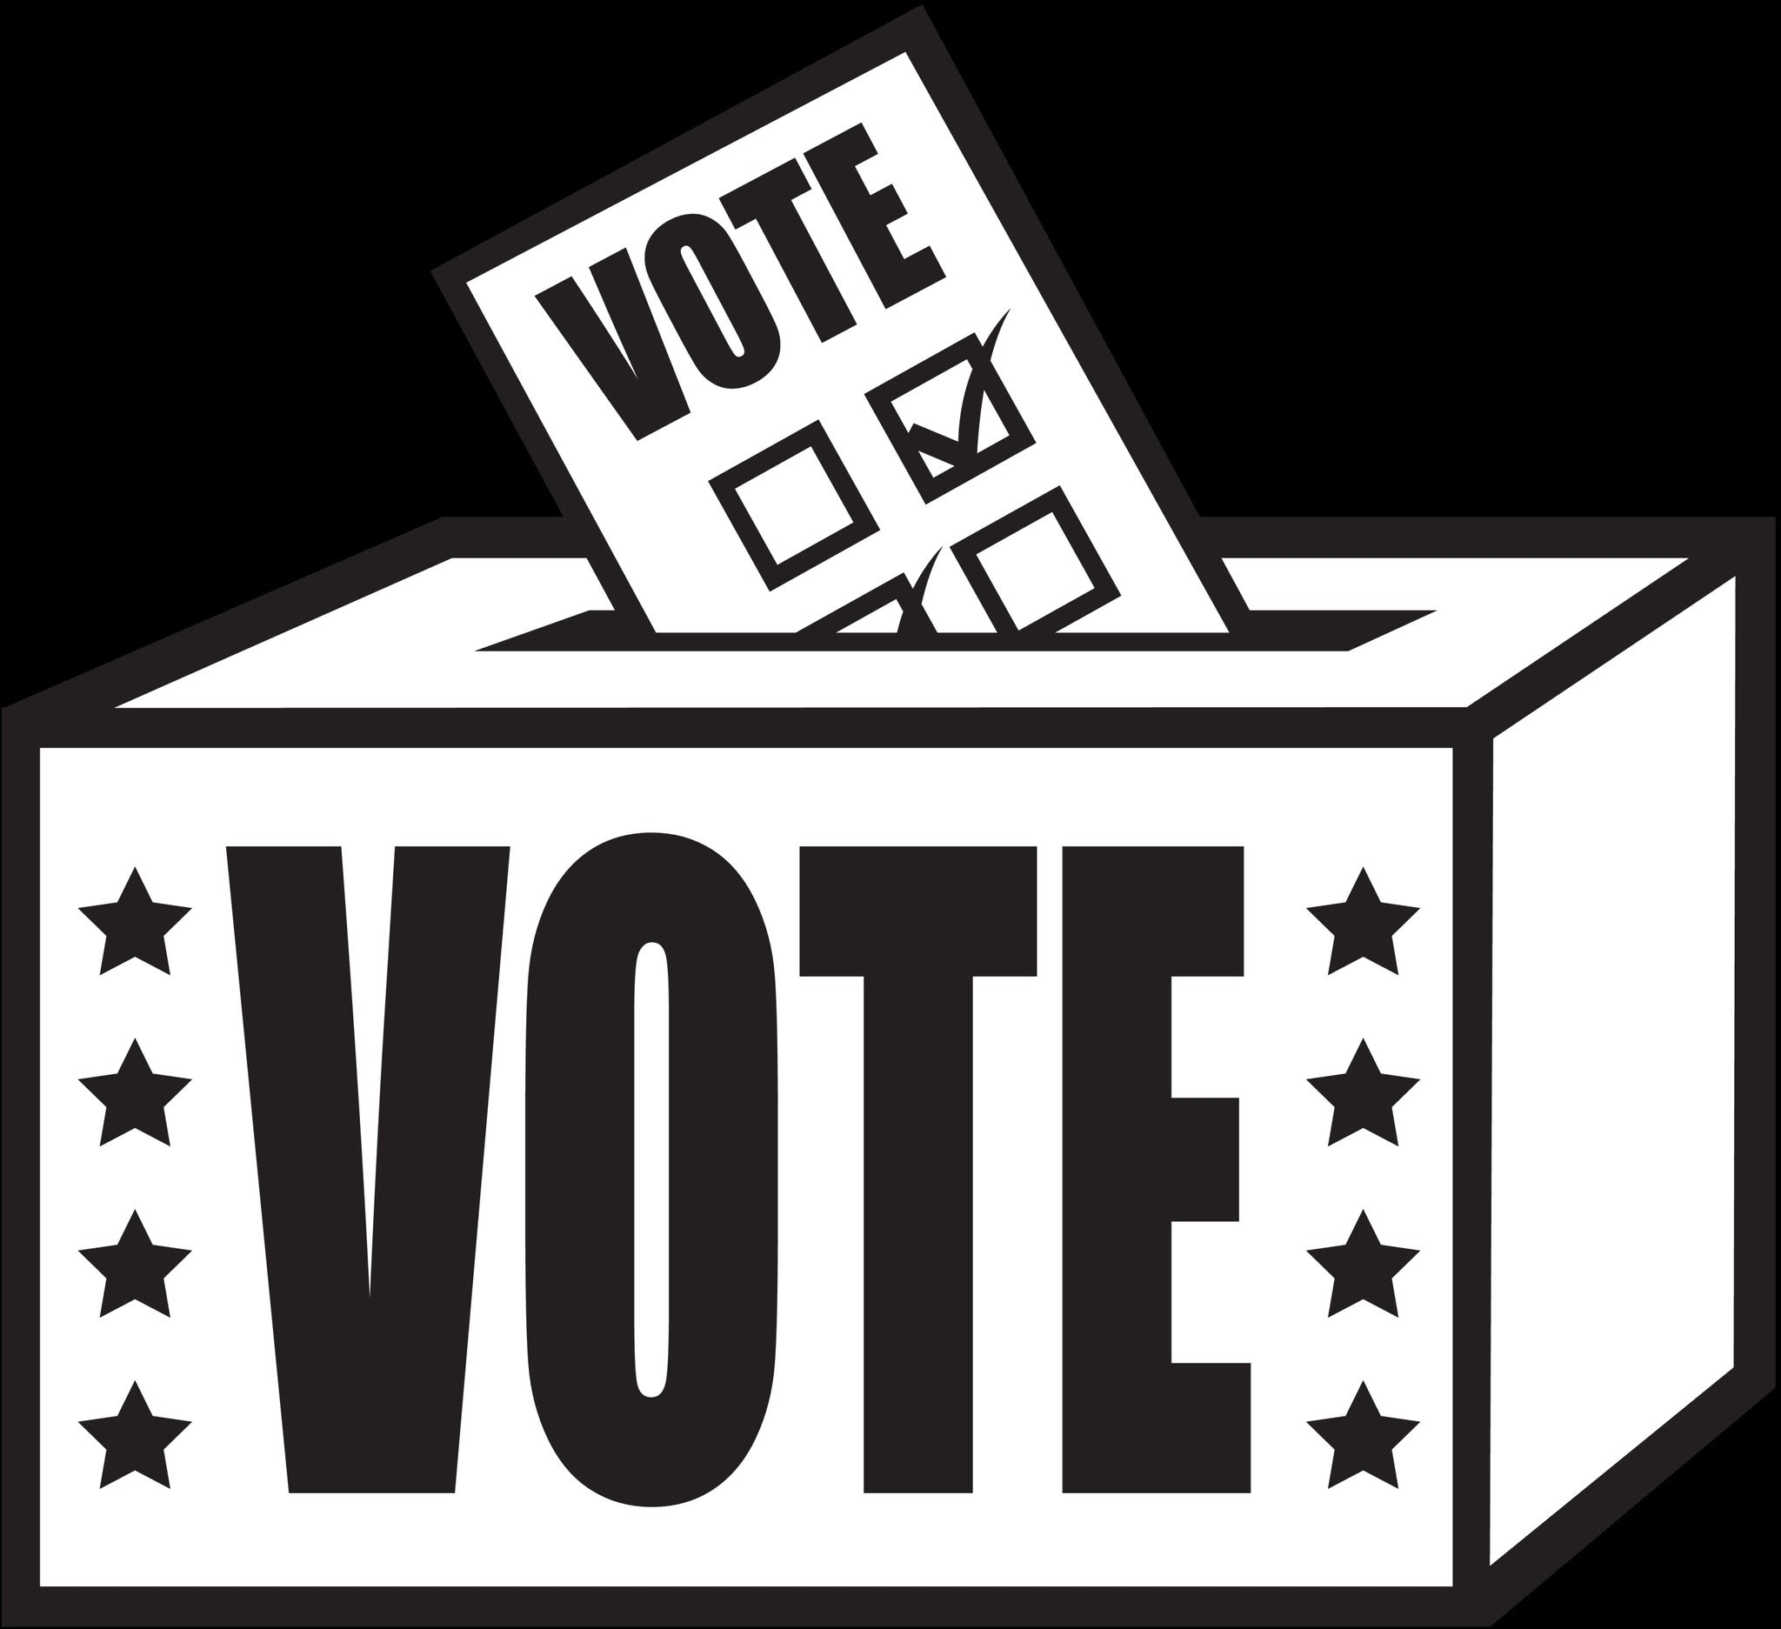
Still Have Questions
Contact Us:
  Email: elections@co.coos.or.us
  Phone: (541) 396-7610
  In Person: 250 N Baxter St, Coquille, OR 97423
Visit our Website:
https://co.coos.or.us/elections

